Slide 1


Towards Improved Certification of Complex
FinTech Systems – A Requirements-based Approach
Sepehr Sharifi, Daniel Amyot, John Mylopoulos, Patrick McLaughlin, Ray Feodoroff
School of Electrical Engineering & Computer Science | Brane Inc.
uOttawa.ca | brane.capital

Slide 2
Background
Financial system certification starts with 3rd party audits.
Software-intensive fintech systems lead to less trust from the stakeholders.
Existing certifications and best practices are insufficient.
Notes:
Financial service providers are subjected to certification and regulatory requirements. They have to be audited by 3rd parties (usually the consulting companies) as a first step in providing assurances to the regulatory stakeholders.
As fintech systems are becoming more software-intensive and complex, stakeholders such as regulators, underwriters, etc. have more challenges in trusting such systems.
There are existing certification processes and best practices, such as CPA SOC certifications however, the stakeholders still require extra assurances to certify the fintech systems activities.

Slide 3
Motivation
Financial service providers should show that they have established (operational) controls in their system, such that it minimizes the risk of losing clients’ assets.
Even if appropriate controls were put in place, how can they communicate effectively with the stakeholders which have different frameworks with mainly backgrounds in finance and law.

Slide 4
Research Question & Proposed Solution
How to evaluate the safety of the FinTech system and convey its results to the regulators effectively and efficiently?
Safety-based evaluation and design.
Graphical goal modelling.
Goal-based assurance cases.
Notes:
Evaluate the systemic safety and devise operational controls that address the concerns of multiple stakeholders. (STPA)
Capture the results of safety analysis and the controls in a clear and traceable manner. (URN)
Communicate the results to the stakeholders effectively. (Assurance Case)

Slide 5
Proposed Guidelines to Improve Certification
Step-1 (Identify the stakeholders)
Step-2 (Create a strategic dependency model using GRL)
Step-3 (Expand the functional goals using UCMs)
Step-4 (Perform STPA):
  Step-4.1 (Define the systems boundary)
  Step-4.2 (Define the hierarchical control structure)
  Step-4.3 (Identify Unsafe Control Actions (UCAs))
  Step-4.4 (Identify loss scenarios)
  Step-4.5 (Elicit safety constraints and requirements)
Step-5 (Create assurance cases based on STPA-related argumentation)

Slide 6
Case Study: Step 1
System Operations: Normal Operators (Finance Manager and Technical Users), Maintenance Ops (Hardware, Software), Operational Support (Transaction Mining, Customer Support), Interfacing System (Cloud, Internal Network).
System: Internal Consultants (Compliance Officer), Client (Investors, Management), Functional Beneficiary (Institutional Funds).
System Environment: Customer (White-label Partners), Interfacing System (Crypto-exchanges, Blockchains Platforms, Insurers), Regulators (Securities, Judiciary, Tax and KYC/AML2 Authorities, Non-statutory Regulators including standards, consortia, and Self-Regulatory Organizations), Negative Actors (Competitor, Hacker), External Consultants (Business Auditor, Security Specialist, Legal Counsel)

Slide 7
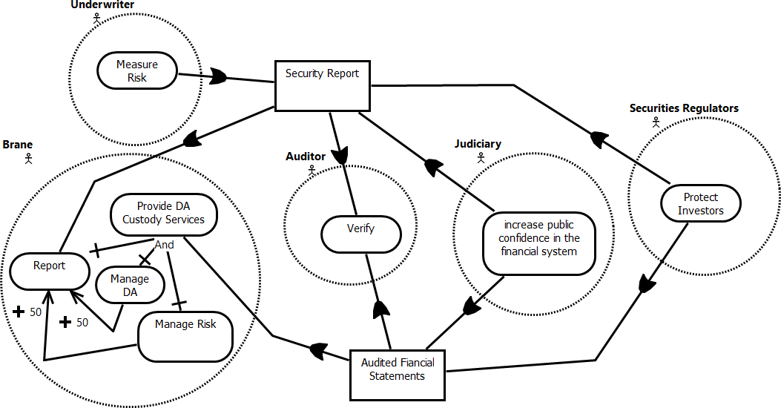
Case Study: Step 2

Slide 8
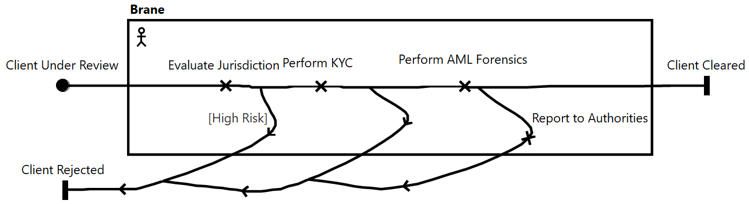
Case Study: Step 3

Slide 9
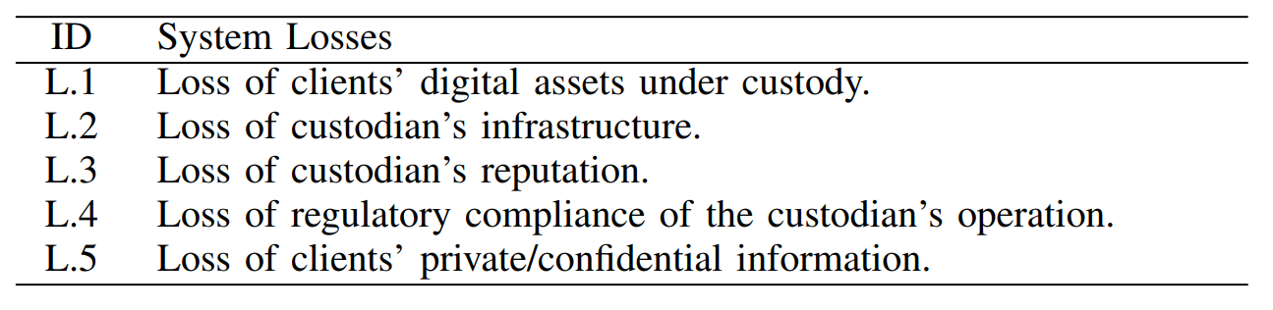
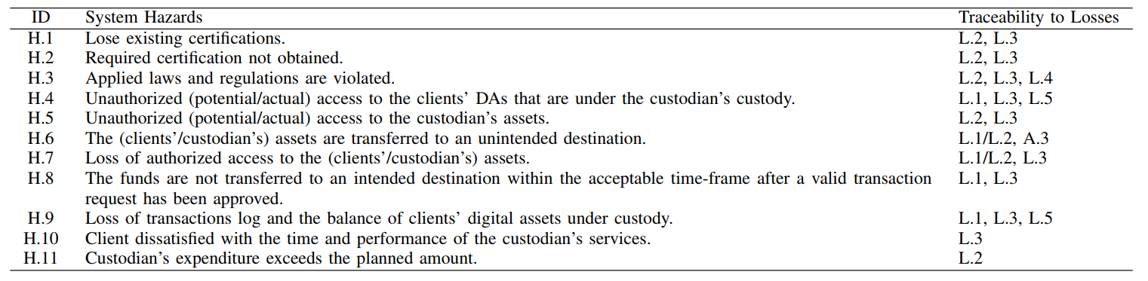
Case Study: Step 4.1

Slide 10
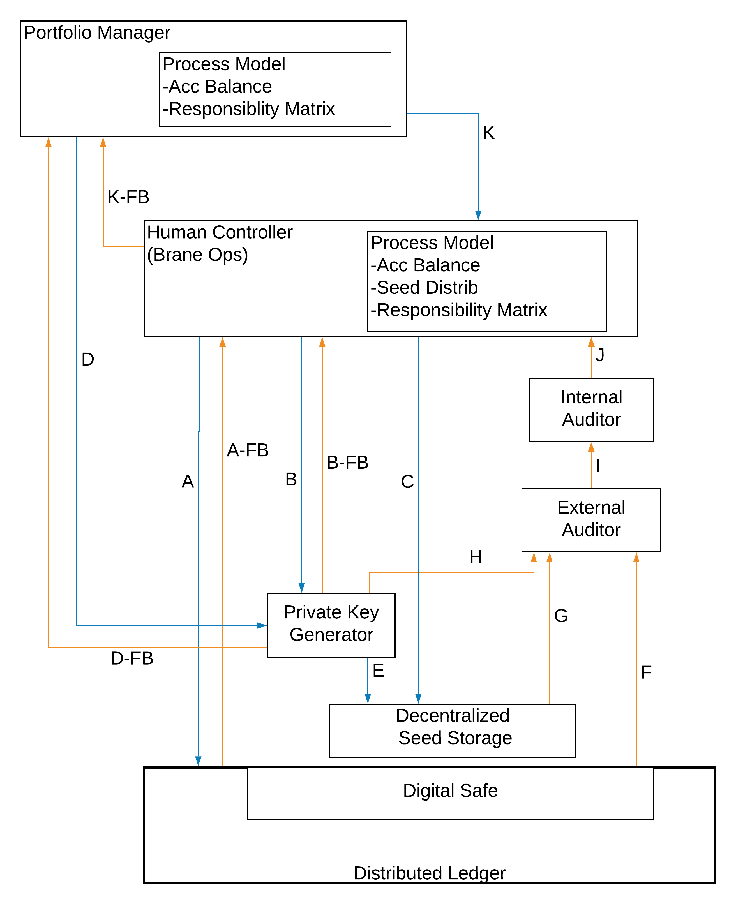
Case Study: Step 4.2
Controller
Control
Command
Feedback
Controlled
System/
Process

Slide 11
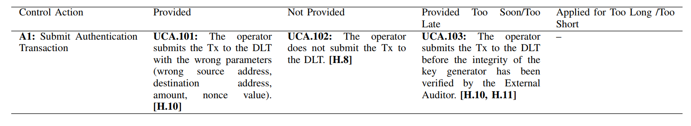
Case Study: Step 4.3
Operator
A1: Submit Authentication Transaction
Digital Safe

Slide 12
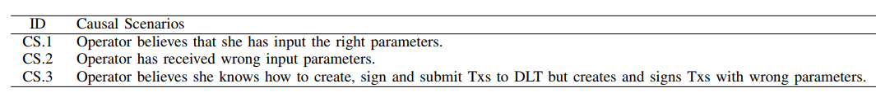
Case Study: Step 4.4
UCA.101: The operator submits the transaction to the digital safe with incorrect parameters. [H.10]

Slide 13
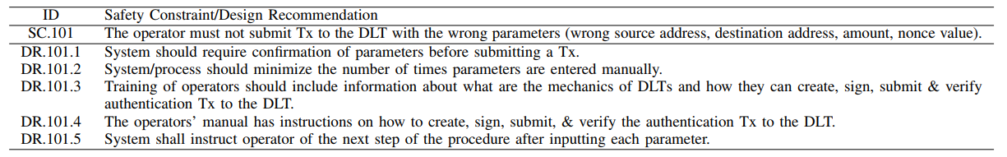
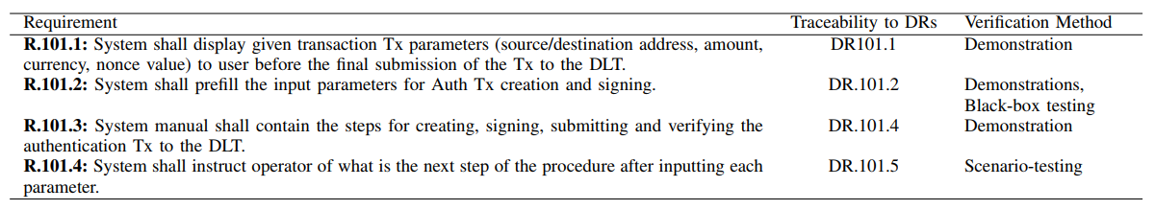
Case Study: Step 4.5

Slide 14
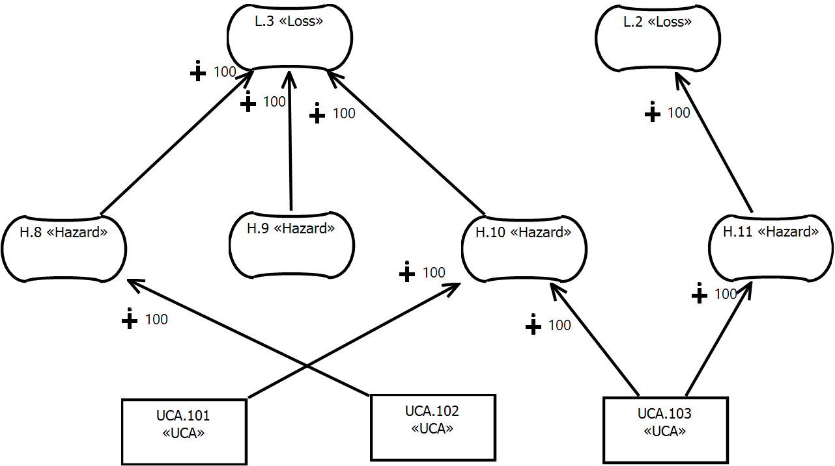
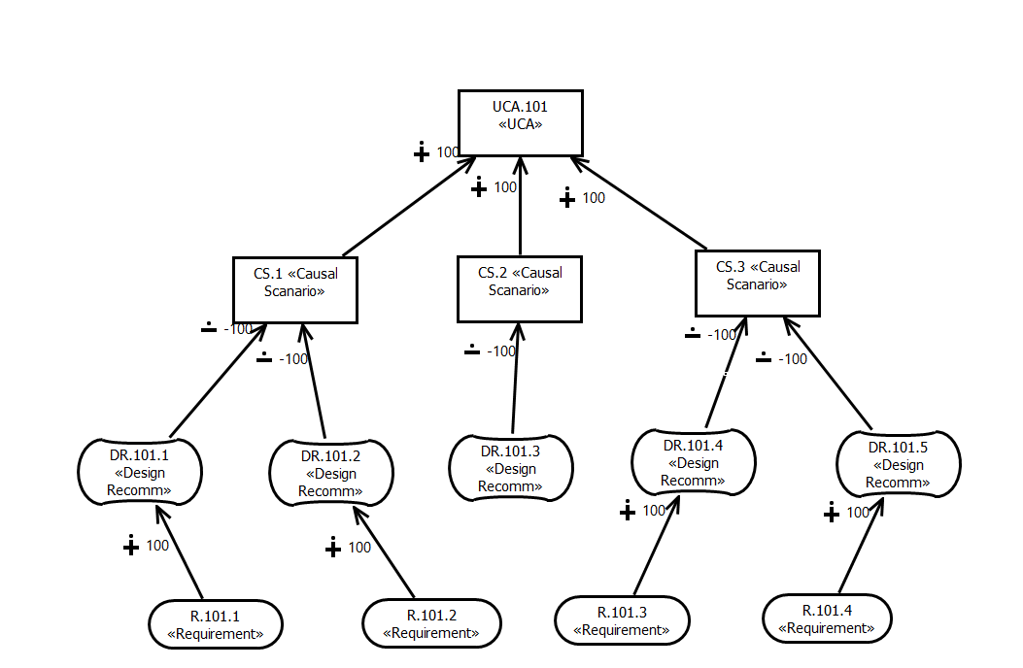
Case Study: Step 5

Slide 15
Our Lessons Learned
Many meetings with every stakeholder is required.
Currently focused on privacy and safety. What about security and ethical considerations (e.g., fairness, lack of discrimination, and lack of bias)?
Design of traceable and verifiable controls.
(Adapted) guidelines could be applied to other socio-technical.
Notes:
Design and certification of fintech systems require frequent meetings with various stakeholders, especially regulators, to better operationalize their goals and requirements.
Currently focused on privacy and safety. What about other systemic qualities such as security, and many ethical considerations, including fairness, lack of discrimination, and lack of bias, ...?
System developers were able to introduce controls to the systems that were explicitly traceable to the hazards that they were trying to address (with explicit verification method).
Guidelines could potentially be applied to socio-technical systems in other domains (e.g., healthcare, public administration). Although the implementation of the steps should be adapted to the domain.

Slide 16
Industry Partner’s Lessons Learned
Goal modelling enables the fintech enterprise to think about the stakeholders and their perspectives thoroughly. It confirms the assumption that we all have in the community.
The guidelines provided a consistent internal enterprise terminology which allowed a more effective communication.
The industry partner discovered some risks that were a surprise to them, e.g.: SC.8, SC21-23

Slide 17
Limitations
One case study.
Manual implementation of the steps by the authors.
Confidential data.
Lack of quantitative evidence.
Notes:
The guidelines were applied to one system only.
All steps were done manually by the authors, possibly introducing bias. However, we expect some parts to be automatable in the future.
Much of the artifacts produced by the research contain confidential information that cannot be publicly shared; this negatively impacts scrutiny in this paper.
Although many stakeholders involved in the project, such as the management and the auditors, confirmed informally that this approach is clearer than the previous certification audits and reporting methods, additional data and formal assessments are needed to confirm the scale of cost, time, and thoroughness improvement resulting from these guidelines.

Slide 18
Future Work
Development of an integrated tool to support and automate much of the steps listed in the guidelines. (possibly a URN profile?)
Apply the steps to more case studies.
Apply the guidelines to other systemic qualities such as availability, security, and integrity.
Gather empirical evidence of applying the guidelines to certify fintech systems.

Slide 19
Towards Improved Certification of Complex
FinTech Systems – A Requirements-based Approach
Sepehr Sharifi, Daniel Amyot, John Mylopoulos, Patrick McLaughlin, Ray Feodoroff
School of Electrical Engineering & Computer Science | Brane Inc.
uOttawa.ca | brane.capital

