Slide 1
Fraunhofer FOKUS Institute for Open Communication Systems
—
Approach to Generating Functional Test Cases from BPMN Process Diagrams
Lukas Strey, Pauline von Olberg | MoDRE 2022 | Position Paper

Slide 2
Structure
Introduction
Example
Methods for generating functional test cases
Conclusion and open questions

Slide 3
Introduction
BPMN
Popular modelling language used to describe business processes
Control flow notation
Broad set of modelling elements (e.g. pools, swim lanes, activities, gateways, events)
Use Case
Modernisation of the federal budget procedures of Germany
Already existing BPMN diagrams for documentation
Automatic generation of functional test cases to alleviate the work load of the context experts
Gherkin
Keyword notation that is understandable by all stakeholders
Abstracting from the specific technical implementations to be used throughout the entire project

Slide 4
Structure
Introduction
Example
Methods for generating functional test cases
Conclusion and open questions

Slide 5
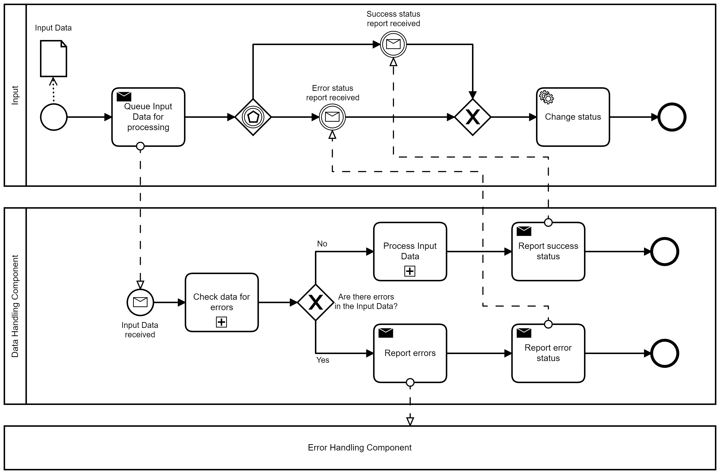
Example
A
B

Slide 6
Structure
Introduction
Example
Methods for generating functional test cases
Conclusion and open questions

Slide 7
Methods for Generating Functional Test Cases
Direct Transformation
Direct transformation from BPMN to Gherkin
Transformation based on a pattern matching between BPMN elements and patterns to the Gherkin syntax
Transformation with an intermediate step
Overall transformation with intermediate model:
Transforming the BPMN process diagram into a more formal model (e.g. a petri net)
Generating functional test cases based on the formal model

Slide 8
Methods for Generating Functional Test Cases
Direct Transformation
Transformation with an intermediate step
Benefits
Lower risk information loss
Lower design and implementation effort
Benefits
Simplified transformation from intermediate model to Gherkin
Possibility to formally verify a BPMN diagram
Limitations
Direct mapping from semantically rich BPMN to simple Gherkin syntax
Limitations
Possible information loss during the first step: mapping the BPMN diagram to the intermediate model
Additional design and implementation effort

Slide 9
Structure
Introduction
Example
Methods for generating functional test cases
Conclusion and open questions

Slide 10
Conclusion and Open Questions
Conclusion
Both methods shall be designed, implemented and evaluated
The evaluation will include a comparison of the automatically generated test cases with manually created ones
Open Questions
Which intermediate model is best suited for the transformation between BPMN and Gherkin?
Is instead a direct transformation feasible?

Slide 11
References
OMG. Business Process Model and Notation Specification Version 2.0. Object Management Group, 2011.
Gerald D. Everett and Jr. Raymond McLeod. Software Testing - Testing Across the Entire Software Development Life Cycle. IEEE Press and Wiley-Interscience, 2007.
IEEE. “IEEE Standard Glossary of Software Engineering Terminology”. In: IEEE Std 610.12-1990, pp. 1-84 (1990).
Chaithep Nonchot and Taratip Suwannasart. “A Tool for Generating Test Case from BPMN Diagram with a BPEL Diagram”. In: Proceedings of the International MultiConference of Engineers and Computer Scientists IMECS 2016 Vol I (2016).
Boodsarin Boonmepipit and Taratip Suwannasart. “Test Case Generation from BPMN with DMN”. In: Proceedings of the 2019 3rd International Conference on Software and e-Business, December 2019, pp. 92-96 (2019).
P. Yotyawilai and T. Suwannasart. “Design of a tool for generating test cases from BPMN”. In: International Conference on Data and Software Engineering (ICODSE), 2014, pp. 1-6 (2014).
S. Sriganesh and C. Ramanathan. “Externalizing business rules from business processes for model based testing”. In: IEEE International Conference on Industrial Technology, 2012, pp. 312-318 (2012).
Sarah Khader and Rana Yousef. “Utilizing Business Process Models to Generate Software Test Cases”. In: IJCSI International Journal of Computer Science Issues, Volume 13, Issue 2, March 2016 (2016).
Ana Paiva et al. “End-to-end Automatic Business Process Validation”. In: Procedia Computer Science, January 2018, volume 130, pp. 999-1004 (2018).
J. C. D. Lima J. L. de Moura A. S. Char˜ao and B. de Oliveira Stein. “Test case generation from BPMN models for automated testing of Web-based BPM applications”. In: 17th International Conference on Computational Science and Its Applications (ICCSA) (2017).
Muhammad Umair Mutarraf et al. “Transformation of Business Process Model and Notation models onto Petri nets and their analysis”. In: Advances in Mechanical Engineering (2018).
Mohamed Z. Ramadan, Hicham G. Elmongui, and Riham Hassan. “BPMN Formalisation using Coloured Petri Nets”. In: Software Engineering Applications, ACTA (2011).
M. zur Muehlen und J. Recker. “How Much Language is Enough? Theoretical and Practical Use of the Business Process Modeling Notation”. In: Proceedings of the 41st Hawaii International Conference on System Sciences (2008).

Slide 12
Contact
—
Lukas Strey lukas.strey@fokus.fraunhofer.de
Pauline von Olberg
pauline.von.olberg@fokus.fraunhofer.de
Fraunhofer FOKUS Institute for Open Communication Systems
Kaiserin-Augusta-Allee 31 10589 Berlin, Germany
info@fokus.fraunhofer.de
www.fokus.fraunhofer.de

